Slide 1
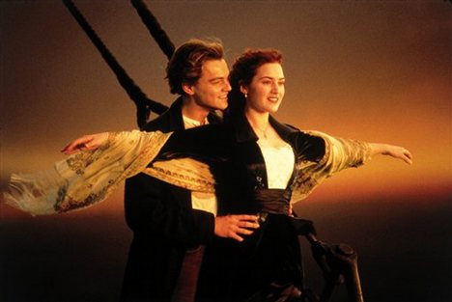

Slide 2
Romanticism in American Art and Literature
1800-1855

Slide 3
What led to Romanticism?
Independence in religion and politics
Expansion in America
Urbanization and industrialism (dehumanization)
Confusion generated by science (Darwin, for example)

Slide 4
Growing Distrust of Reason
Age of Reason
Society is good because it curbs violent impulses.
Romanticism
Civilization corrupts!

Slide 5
Characteristics of Romanticism
1. Individualism
stability of the community
fulfillment of the individual

Slide 6
Characteristics of Romanticism
2. The Rugged Hero
Youthful, innocent, intuitive
One with nature
Loner
Handsome, brave, moral and honorable

Slide 7
Characteristics of Romanticism
3. Individualism in Art
The artist is
-Apart from society
-A social critic and revolutionary
-A genius
-The true philosopher

Slide 8
Characteristics of Romanticism
4. Emotionalism
Backlash against rationalism characterized by Age of Reason
Feeling is the test of authenticity (not reason)

Slide 9
Characteristics of Romanticism
Emotionalism Continued
Imagination, intuition, and inspiration → creation of all art forms
Romantic artist = “inspired creator” (not “technical master”)
Emphasis on spontaneity rather than being precision, control, or realism

Slide 10
Characteristics of Romanticism
Emotionalism Continued
Romantic love is a subject of poetry
Poetry is a form of emotional communication
Painful and pleasurable emotions are equally valid to Romantic poets

Slide 11
Characteristics of Romanticism
5. Rejection of Traditional Authority
Influenced by American and French Revolutions
Authority derives from self
Questioning of government and societal hierarchies
Political statements popular in art

Slide 12
Characteristics of Romanticism
6. Nature and Mysticism
Love of and spiritual involvement with nature
Supernatural, awesome, horrifying, and overwhelming power of nature all highlighted

Slide 13
Characteristics of Romanticism
7. Primitivism
“civilization corrupts”
The child raised with the greatest possible freedom will develop in more admirable ways
Youth and infancy are valued above wisdom of old age
Innocence more valued than experience
Humans born into innocence (Puritans?)

Slide 14
Characteristics of Romanticism
8. Romantic Escapism
Urban vs. Rural settings
The romantic journey is to the countryside
Cities= greed, poverty, and dehumanization (Industrial Revolution)
Nature = escape, independence, moral clarity and purity

Slide 15
The Gothic novel
Wild, haunted landscapes
Supernatural events
Mysterious
Dreams and madness
Interest in unknown and unknowable
Poe was America’s greatest Romantic gothic writer

Slide 16
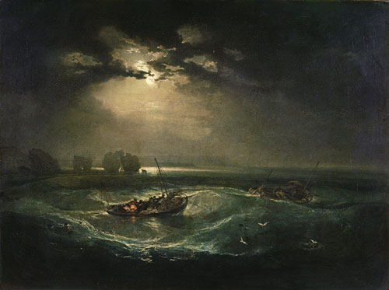
JMW Turner Fisherman at Sea

Slide 17
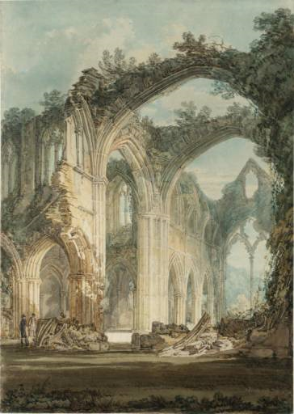
JMW Turner The Chancel and Crossing of Tintern Abbey, Looking Towards the East Window

Slide 18
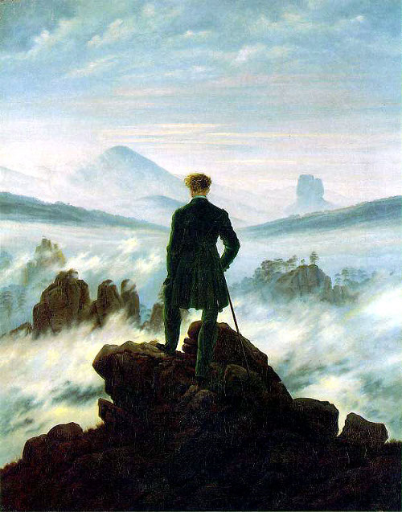
Caspar David Freidrich Wanderer Above the Sea of Fog
Infinite potential and possibility of man
Awesome, mysterious grandeur of nature

Slide 19
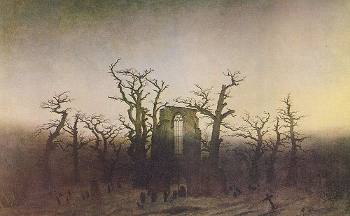
Caspar David Friedrich Abbey on an Oak Forest

Slide 20
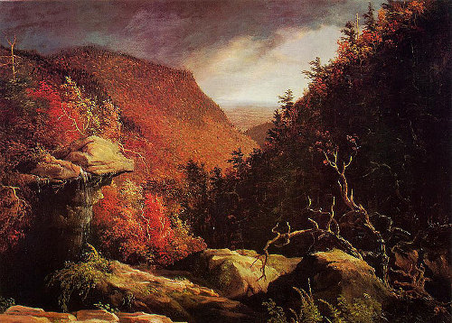
Thomas Cole The Clove Catskills

Slide 21
Thomas Cole The Course of an Empire The Savage State

Slide 22
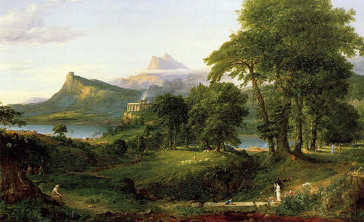
The Arcadian or Pastoral State

Slide 23
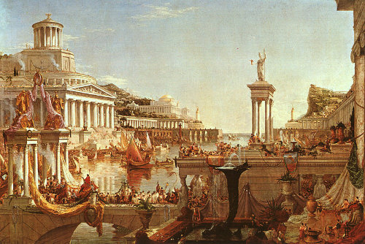
The Consummation of Empire

Slide 24
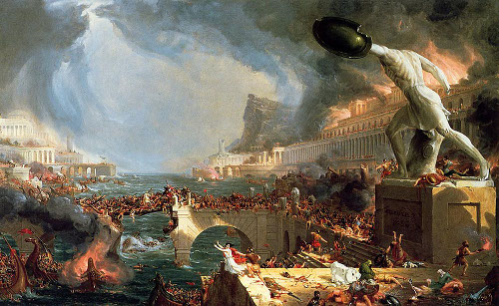
The Destruction

Slide 25
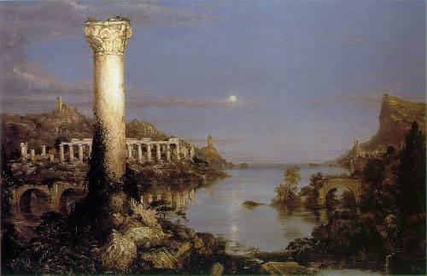
Desolation

